Slide 1















Part A: Stock Price Forecasting
Name: Jon Sham
Class: DAAA/Ft/1B/06
Admin: P2317342

Slide 2

Background
Research
Time series analysis is a powerful tool for forecasting stock prices due to its ability to capture temporal dependencies, trends, and seasonality in market data. By analyzing historical price patterns, time series models can provide accurate predictions of future price movements, aided by high-frequency data and specialized forecasting techniques. These models offer valuable insights for investors and analysts, enabling informed decision-making and optimization of investment strategies.

Slide 3
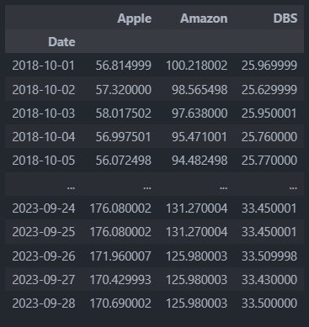
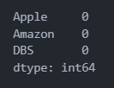
Date Time
Ifor the stocks df convert it to a date data type then we identified missing values in the dataset. To address this, I'll use a backfill method, which fills missing values with the most recent known value. This approach is suitable for time series data as it preserves the temporal order of observations, crucial for maintaining the integrity of time-dependent patterns and trends

Slide 4
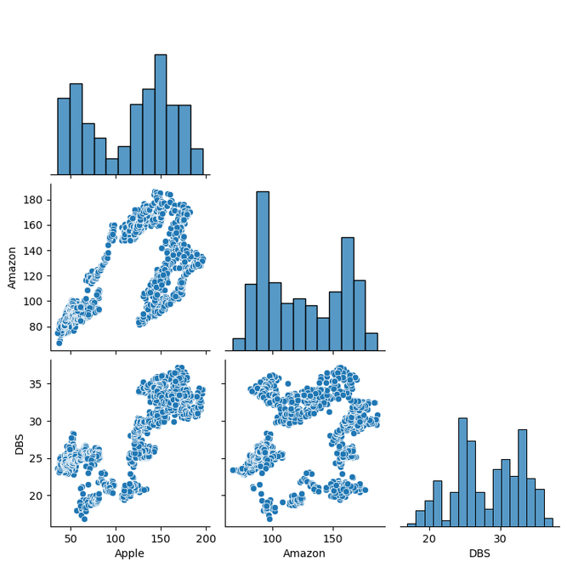
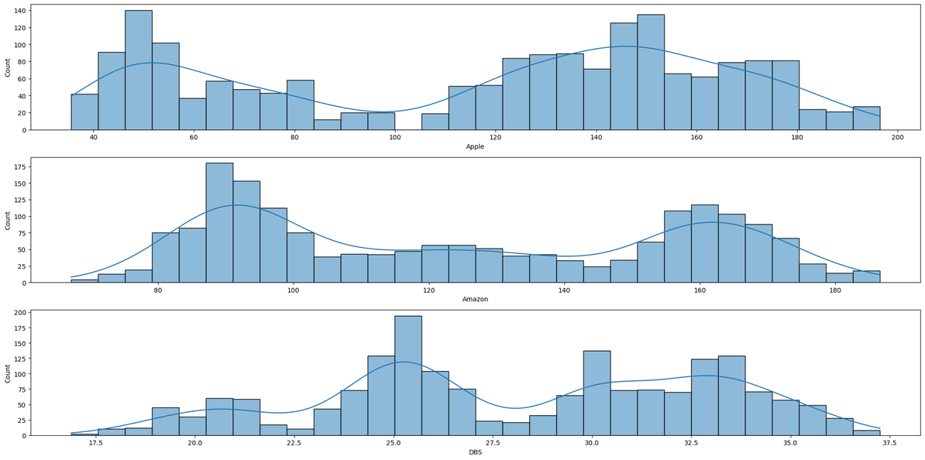
EDA
We can observe that there isn't a strong relationship between each type of consumption. They all exhibit very weak positive or negative correlations
We can observe that the stock prices for Apple are right-skewed, for Amazon they follow a normal distribution, and for DBS they are also skewed to the right

Slide 5
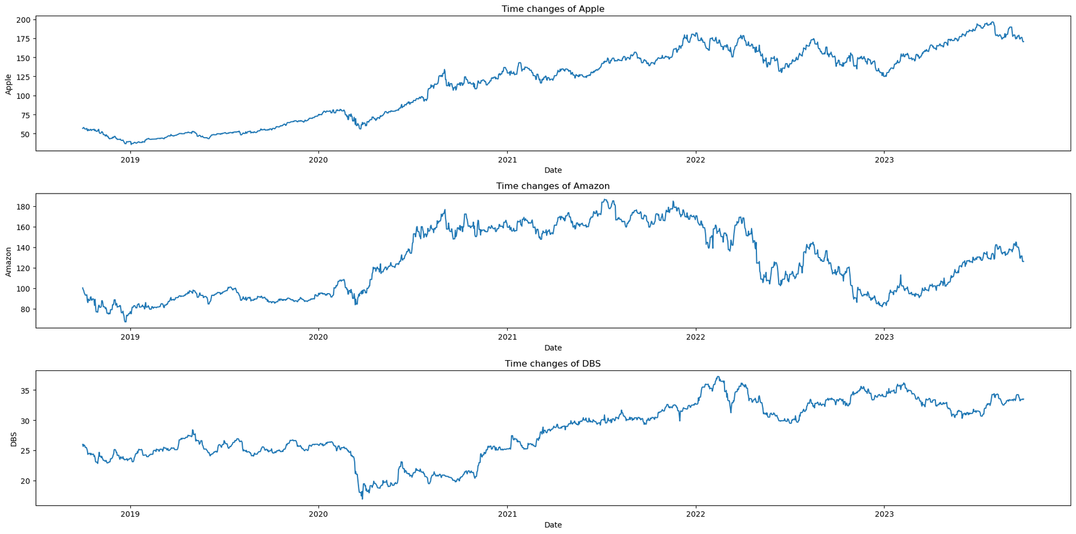
Time Series Visualisation
For Apple, there is a noticeable positive upward trend in stock prices, while for Amazon and DBS, there isn't a clear trend

Slide 6
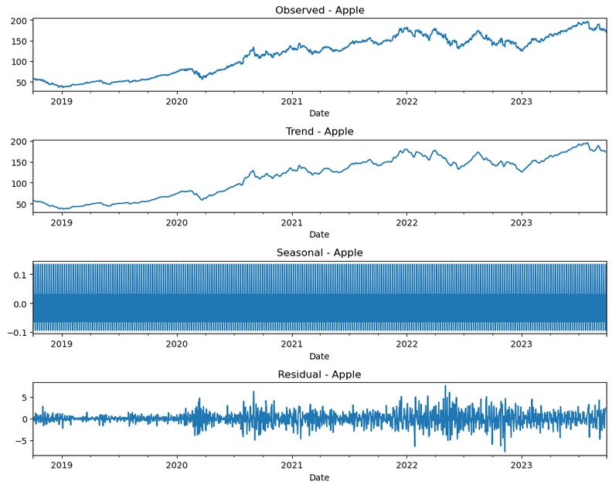
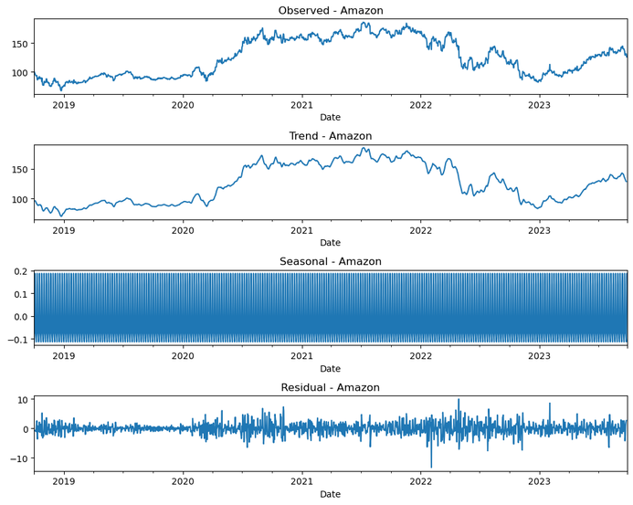
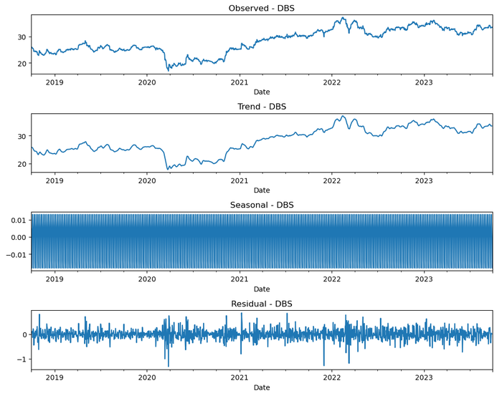
Seasonal Decomposition
All columns had a seasonal decomposition of 7 indicate that the time series data exhibits a weekly seasonal pattern, with variations repeating every 7 observations

Slide 7
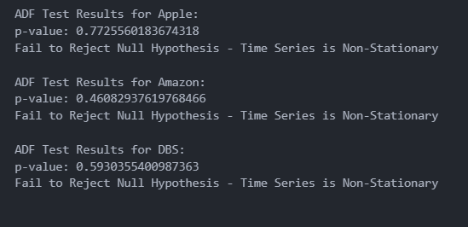
P-Value
Next, I'll perform an Augmented Dickey-Fuller test on the data. This statistical method helps determine whether a time series is stationary or non-stationary by assessing the presence of a unit root. If the p-value obtained from the test is below 0.05, we reject the null hypothesis of non-stationarity, indicating that the time series is stationary. This is essential for ensuring the reliability of my forecasting model
As observed for all columns, the p-value exceeded 0.05, indicating that we fail to reject the null hypothesis. This suggests that the time series is non-stationary

Slide 8
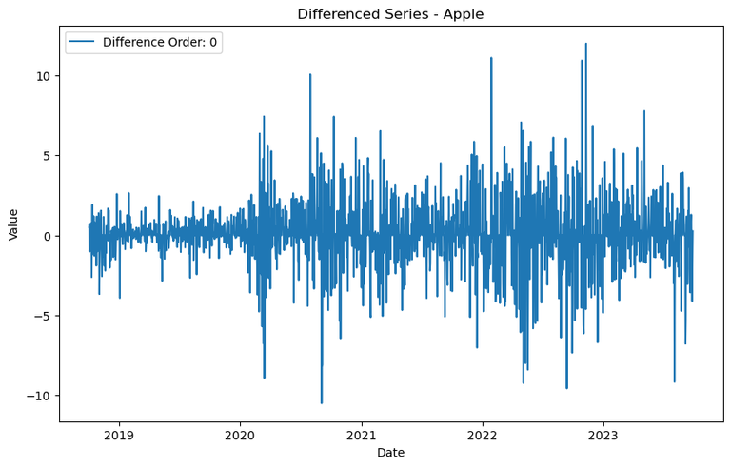
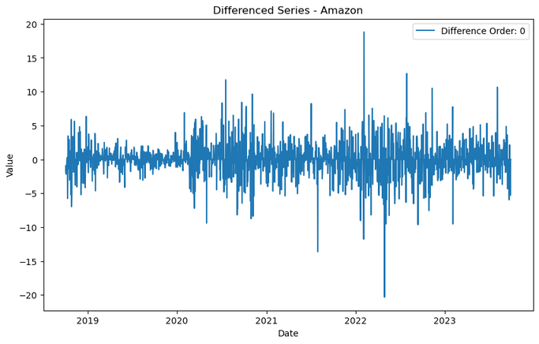
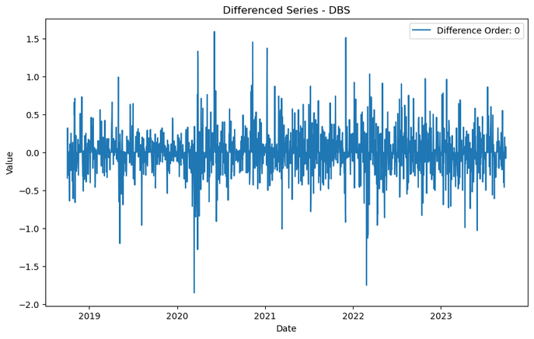
Differencing
Next, I'll perform differencing to make the time series data stationary. Stationarity is crucial for time series analysis, as it ensures that the statistical properties of the data remain constant over time. Differencing helps remove trends and seasonality, stabilizing the mean and variance of the series and facilitating more reliable forecasting model

Slide 9
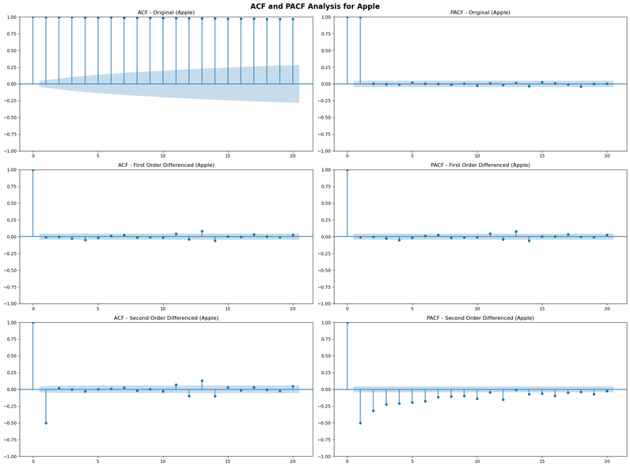


Partial Autocorrelation Function and Autocorrelation Function analysis
**Apple:**
- ACF: Shows a very slight Geometric Decay. This indicates that the autocorrelation values decrease gradually as the lag increases, but the decay is minimal.
- PACF: Shows a significant lag at 1. This means that there is a strong direct relationship between the current observation and the observation one time period ago.
**Amazon:**
- ACF: Also shows a very slight Geometric Decay, similar to Apple.
- PACF: Like Apple, it shows a significant lag at 1, indicating a strong direct relationship between consecutive observations.
**DBS:**
- ACF: Similarly, shows a very slight Geometric Decay.
- PACF: Also shows a significant lag at 1, suggesting a strong direct relationship between the current observation and the observation one time period ago.
In summary, for all three stocks, the ACF plots exhibit a very slight Geometric Decay, indicating a gradual decrease in autocorrelation values as the lag increases, although the decay is minimal. Additionally, the PACF plots show significant lags at 1 for each stock, suggesting a strong direct relationship between consecutive observations. These observations provide insights into the temporal dependencies present in each stock's data, which can guide the selection of appropriate time series models for further analysis and forecasting.

Slide 10
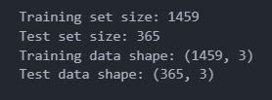
Splitting Data
we will use 80% of the data for training and 20% for testing

Slide 11
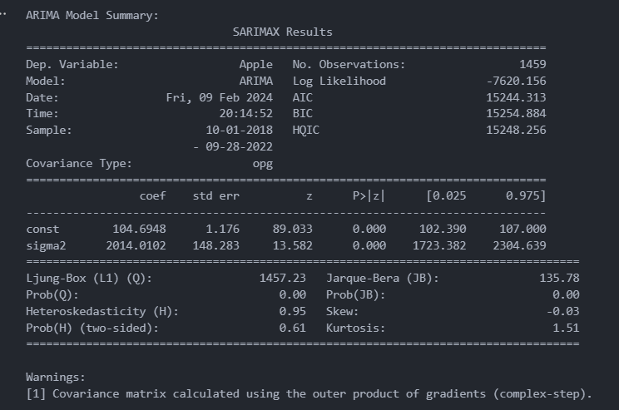
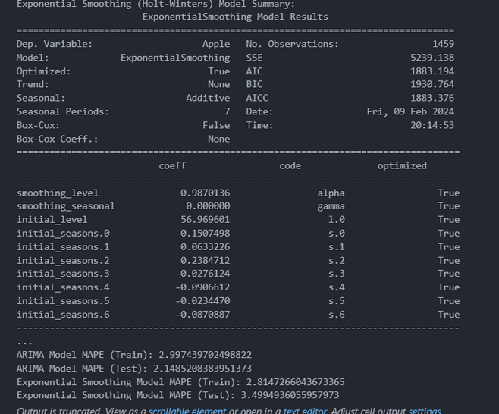
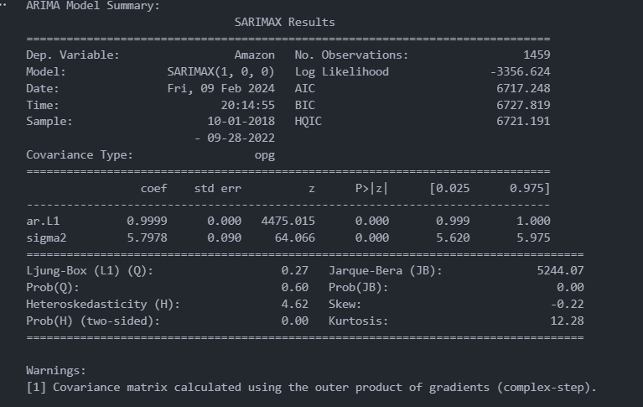
Baseline Models
We will compare the performance of Holt's Exponential Smoothing, ARIMA, and SARIMAX models to determine the most suitable model for predicting stocks. Evaluation will be based on metrics such as Mean Absolute Percentage Error, Akaike Information Criterion, and Bayesian Information Criterion

Slide 12
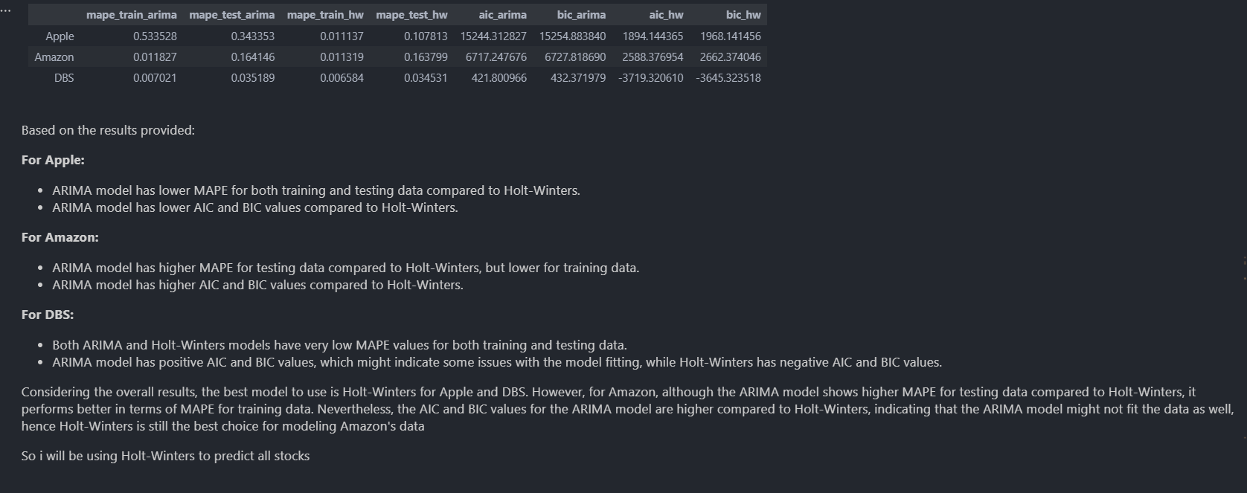
Choosing Best Model

Slide 13
Model Improvement
This loop is to find the optimal parameter combination for my Exponential Smoothing model applied to predict stock prices. It iterates through various combinations of trend, seasonal, seasonal periods, damped trend, and use_boxcox parameters, fitting models and evaluating their performance using mean squared error, ultimately identifying the combination that yields the lowest MSE as the best parameters for the model

Slide 14
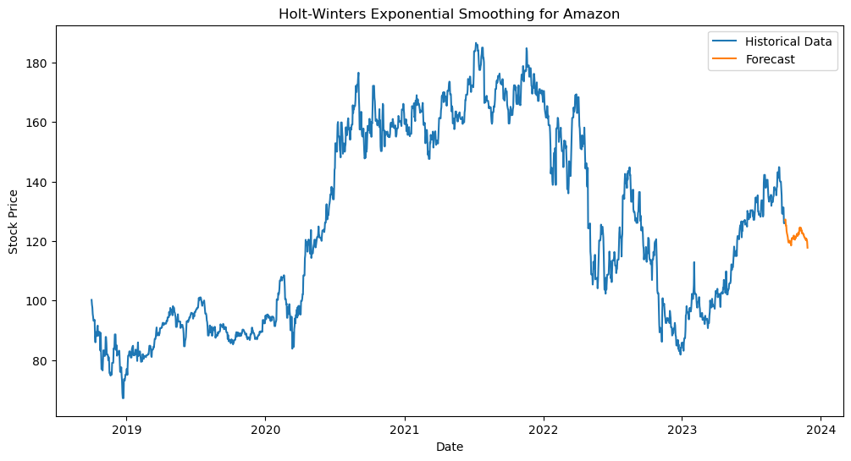
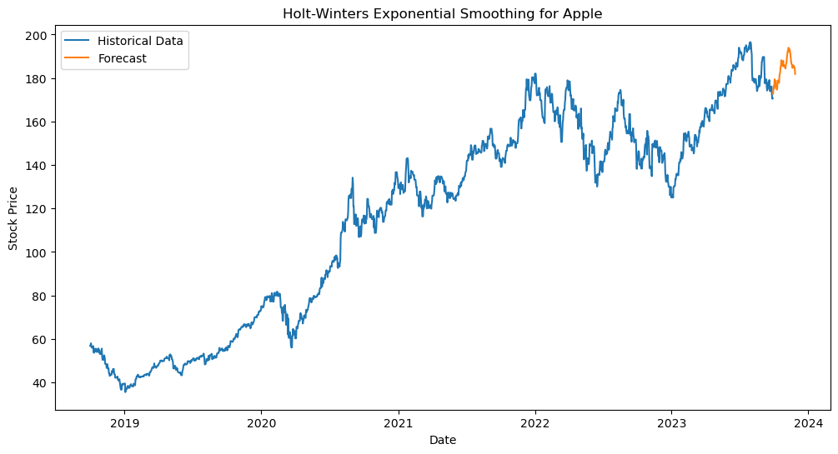
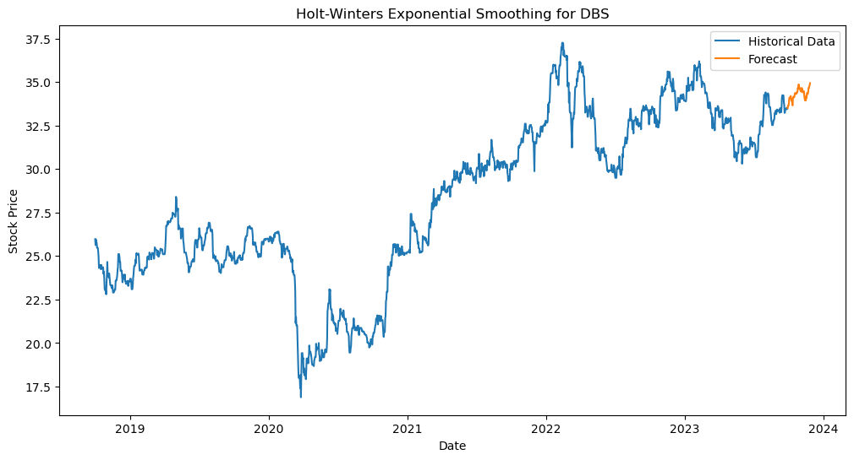
Final Models

